Slide 1
Refresher on rates and rounding

Slide 2
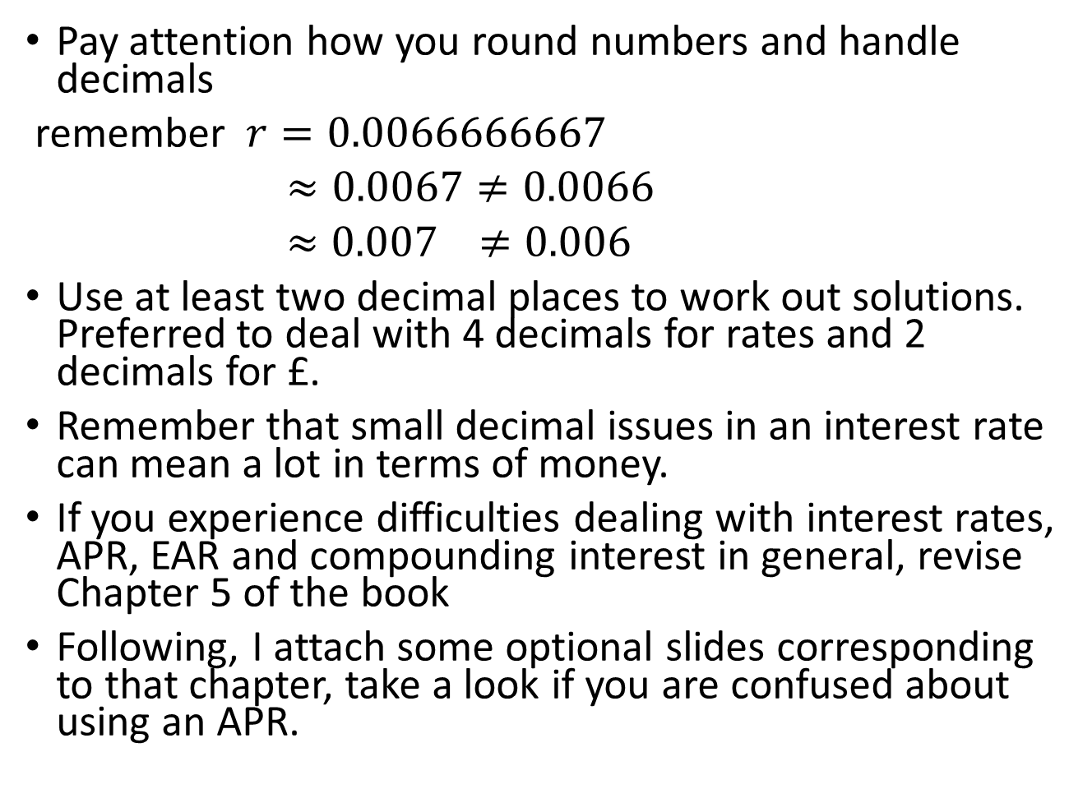
Pay attention how you round numbers and handle decimals
remember $r=0.0066666667$
$≈0.0067≠0.0066$
$≈0.007$ $≠0.006$
Use at least two decimal places to work out solutions. Preferred to deal with 4 decimals for rates and 2 decimals for £.
Remember that small decimal issues in an interest rate can mean a lot in terms of money.
If you experience difficulties dealing with interest rates, APR, EAR and compounding interest in general, revise Chapter 5 of the book
Following, I attach some optional slides corresponding to that chapter, take a look if you are confused about using an APR.

Slide 3
Annual Percentage Rates (1 of 4)
The annual percentage rate (APR), indicates the amount of simple interest earned in one year.
Simple interest is the amount of interest earned without the effect of compounding.
The APR is typically less than the effective annual rate (EAR).

Slide 4
Annual Percentage Rates (2 of 4)
The APR itself cannot be used as a discount rate.
The APR with k compounding periods is a way of quoting the actual interest earned each compounding period:

Slide 5
Annual Percentage Rates (3 of 4)
Converting an APR to an EAR
The EAR increases with the frequency of compounding.
Continuous compounding is compounding every instant.

Slide 6
Annual Percentage Rates (4 of 4)
Table 5.1 Effective Annual Rates for a 6% APR with Different Compounding Periods
Compounding Interval | Effective Annual Rate
Annual | E Ay R = 1 +, 0.06 divided by 1, to the first power minus 1 = 6 percent
Semiannual | E Ay R = 1 +, 0.06 divided by 2, squared minus 1 = 6.09 percent
Monthly | E Ay R = 1 +, 0.06 divided by 12, to the twelfth power minus 1 = 6.1678 percent
Daily | E Ay R = 1 +, 0.06 divided by 365, to the power of 365 minus 1 = 6.1831 percent.
A 6% APR with continuous compounding results in an EAR of approximately 6.1837%.

Slide 7
Textbook Example 5.2 (1 of 4)
Converting the APR to a Discount Rate
Problem
Your firm is purchasing a new telephone system, which will last for four years. You can purchase the system for an upfront cost of $ 150,000, or you can lease the system from the manufacturer for $4000 paid at the end of each month. Your firm can borrow at an interest rate of 5% APR with semiannual compounding. Should you purchase the system outright or pay $4000 per month?

Slide 8
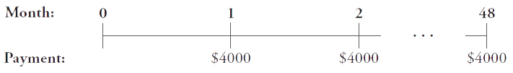
Textbook Example 5.2 (2 of 4)
Solution
The cost of leasing the system is a 48-month annuity of $4000 per month:
We can compute the present value of the lease cash flows using the annuity formula, but first we need to compute the discount rate that corresponds to a period length of one month. To do so, we convert the borrowing cost of 5% APR with semiannual compounding to a monthly discount rate. Using Eq. 5.2,
the APR corresponds to a six-month discount rate of
To convert
a six-month discount a one-month discount rate, we compound the six-month
rate by
using Eq. 5.1:

Slide 9
Textbook Example 5.2 (3 of 4)
(Alternatively, we could first use Eq. 5.3 to convert the APR to an EAR:
Then we can convert the EAR to
a monthly rate using Eq. 5.1: (1.050625)
– 1 = 0.4124% per
month.) Given this discount rate, we can use the annuity formula (Eq. 4.9) to compute the present value of the 48 monthly payments:
We can also use the annuity spreadsheet:
blank | NPER | RATE | PV | PMT | FV | Excel Formula
Given | 48 | 0.4124% | blank | − 4,000 | 0 | blank
Solve for PV | blank | blank | 173,867 | blank | blank | = PV(0.004124,48,4000,0)

Slide 10
Textbook Example 5.2 (4 of 4)
Thus, paying $4000 per month for 48 months is equivalent to paying a present value of $173,867 today. This cost is $173,867 − $150,000 = $23,867 higher than the cost of purchasing the system, so it is better to pay $150,000 for the system rather than lease it. We can interpret this result as meaning that at a 5% APR with semiannual compounding, by promising to repay $4000 per month, your firm can borrow $173,867 today. With this loan it could purchase the phone system and have an additional $23,867 to use for other purposes.

Slide 11
Alternative Example 5.2 (1 of 3)
Problem
A firm is considering purchasing or leasing a luxury automobile for the CEO. The vehicle is expected to last three years. You can buy the car for $65,000 up front , or you can lease it for $1,800 per month for 36 months. The firm can borrow at an interest rate of 8% APR with quarterly compounding. Should you purchase the system outright or pay $1,800 per month?

Slide 12
Alternative Example 5.2 (2 of 3)
Solution
The first step is to compute the discount rate that corresponds to monthly compounding. To convert an 8% rate compounded quarterly to a monthly discount rate, compound the quarterly rate using Equations 5.3 and 5.1:

Slide 13
Alternative Example 5.2 (3 of 3)
Solution
Given a monthly discount rate of 0.66227%, the present value of the 36 monthly payments can be computed:
Paying $1,800 per month for 36 months is equivalent to paying $57,486 today. This is $65,000 − $57,486 = $7,514 lower than the cost of purchasing the system, so it is better to lease the vehicle rather than buy it.

